Slide 1

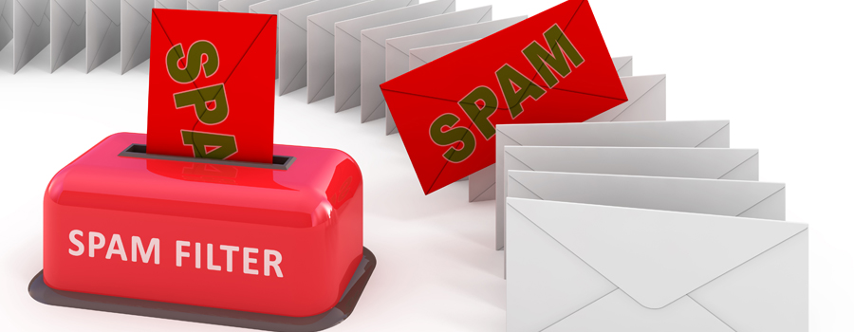
CSCE 5290: Natural Language Processing - SPAM FILTERING
Team Members -
Shishira Rudrabhatla (11560633)
Nathisha Marru (11560642)
Abhishek Rangineni (11435098)
Venkata Sai Rahul Kumar Katta (11505841)

Slide 2
Introduction
What do we know about spam?
Annoying Emails, Text messages (SMS)
Social media, Phone calls
Spam Emails not only annoying but also dangerous to consumers.
Spam stands for Sending and Posting Advertisement in Mass.
Spam is a business communication; its semantics are typically fashioned with a positive meaning. It makes use of sentiment analysis to generate the polarity scores for each message, and then assesses the accuracy of spam filtering classifiers both with and without the polarity scores.

Slide 3
What is Spam?
Spam is typically defined as undesired text that is sent or received over social media platforms like Facebook, Twitter, YouTube, e-mail, etc.
Emails that involves sending identical or nearly identical messages to thousands (or millions) of recipients.
Spam is any unsolicited communication sent in bulk.
Spam emails are almost always commercial and driven by a financial motive.
Spammers use spambots to crawl the internet looking for email addresses that are used to create email distribution lists. The lists are used to send junk email to multiple email addresses -- usually hundreds of thousands -- at one time.
Cybercriminals can also use spamming to distribute malicious software and steal personal data from unsuspecting targets.

Slide 4
Goals & Objectives
Motivation:
Spammers are constantly looking for ways to get around existing filters, new filters must be created to stop spam. It is due to this major increase in spam emails that has led to the necessity of this project with an aim to train spam-filtering models better and stay up to date with the latest tricks spammers are coming up with every day and try to filter emails in the most effective ways possible.
Significance:
It is critical to take extra precautions to safeguard your equipment, especially if it processes sensitive information like user data. This is since clicking on a spam email might put your computer and personal information at risk of being infected with malware.
Spam filtering implementation is crucial for every firm as it does not only helps keep junk out of email inboxes, but it also improves the functionality and usefulness of business communications by ensuring that they are only utilized for what they were intended for.
Objectives:
Typically, text classification is the primary methodology used for email screening.
The objective is to develop a Python-based spam filtering approach in which relevant spam are first filtered from the training dataset and then used to generate training and testing tables for various data mining algorithms.

Slide 5
SPAM Filtering Technique - NLP
Spam filtering is a mechanism used to filter spam messages or emails to prevent its delivery.
The volume of unsolicited email has significantly increased, necessitating the development of more robust and efficient antispam filters.
Machine learning algorithms have been used to successfully identify and filter spam emails.
Employing sender information and text content-based NLP has proven to be beneficial for spam filtering techniques.
Spam filtering implementation is crucial for every firm as it does not only helps keep junk out of email inboxes, but it also improves the functionality and usefulness of business communications by ensuring that they are only utilized for what they were intended for.
Since many email-based attacks attempt to deceive users into clicking on a malicious file, asking them for their credentials, and other information, spam filtering becomes one of the most needed functionalities in such cases.

Slide 6
Features of Spam Filtering
The proposed spam filtering system is expected to have the following features once fully implemented:
Effective performance supported by the advantages and powers in natural language processing.
Ability to categorize your emails as spam by training the classifier on your own dataset.
Simplicity in usage.
Fast performance once the training of the classifier is completed.
Better model with higher accuracy in filtering spam e-mails.

Slide 7
Background
It is feasible to develop a system or an application to use text mining methods and semantic analysis to detect spam in various forms models of language, respectively.
This project concentrates on the application of Sentiment Analysis among all NLP methods to further analyze the detected spam messages.
This is a distinctive if we contrast this strategy with the conventional short spam detection methods, which pays attention to automated text categorization but ignores sentiment analysis.
Bayesian filtering classifiers have been improved, reaching to a 99.21% of accuracy by producing the polarity score of each message using sentiment classifiers, and then comparing spam filtering classifiers with and without the polarity score in terms of accuracy.

Slide 8
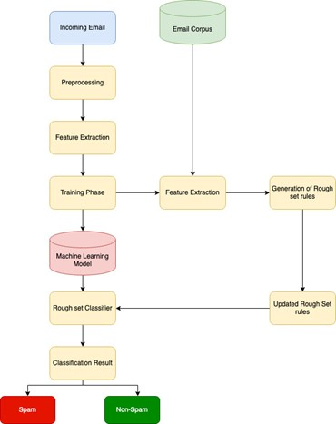
Model Diagram

Slide 9
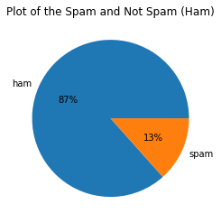
Dataset and Features Design
The International Movie Database (IMDb) reviews for 50,000 reviews of films from across the world make up the dataset used for sentiment analysis; it's a binary classification dataset that classifies each review as either positive or negative.
The project is to analyze the spam and non-spam messages, the selected features for the operation were:
- label
- message

Slide 10
Analysis
Spam filtering, exploratory data analysis (EDA) is conducted on the dataset. A visualization of the available spam and ham messages in the dataset is generated for further observations and analysis.
For NLP projects, the torch.text library is a fantastic resource as it includes a loader for various popular NLP datasets, including the one we will used for the project, as well as a whole pipeline for data abstraction, data vectorization, data loaders, and data iteration.
For Python sentiment analysis, the IMDB reviews dataset is used and retrieved.
Finally, we organize the data we have into a training, testing, and validation batch in order to get it ready to be given to the model in batches of 64 samples at a time. and divided into train, test, and validation splits.

Slide 11
Results
Now, both the spam filtering model and sentiment analysis model implemented, both are then combined to analyze the relationship between the spam messages, non-spam messages and their respective sentiments in each category.
An observation was made when analysis for the dataset was made for its overall sentiment based on whether the message was spam or not.

Slide 12
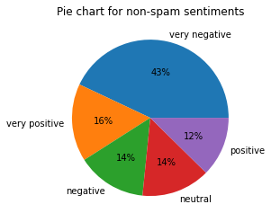
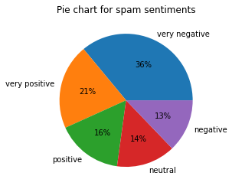

Slide 13
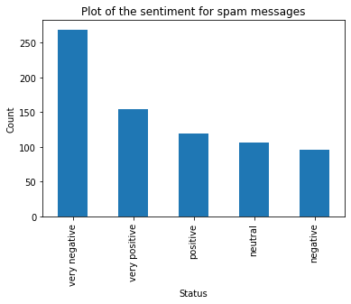
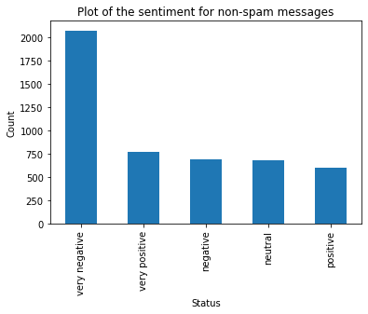

Slide 14
References
Ezpeleta, E., Zurutuza, U., & Gómez Hidalgo, J. M. (2016, April). Does sentiment analysis help in bayesian spam filtering?. In International Conference on Hybrid Artificial Intelligence Systems (pp. 79-90). Springer, Cham.
Ghiassi, M., Lee, S., & Gaikwad, S. R. (2022). Sentiment analysis and spam filtering using the YAC2 clustering algorithm with transferability. Computers & Industrial Engineering, 165, 107959.
Whitelaw, C., Garg, N., & Argamon, S. (2005, October). Using appraisal groups for sentiment analysis. In Proceedings of the 14th ACM international conference on Information and knowledge management (pp. 625-631).
https://www.researchgate.net/publication/220553508_Survey_on_Spam_Filtering_Techniques
https://www.researchgate.net/publication/228940659_Using_old_spam_and_ham_samples_to_train_emai l_filters
https://link.springer.com/article/10.1007/s10462-022-10195-4
https://www.kaggle.com/datasets/uciml/sms-spam-collection-dataset

Slide 15

THANK YOU

